Slide 1

Securing a Small Business Network
Supervised by: Eng. Amr Adel

Slide 2
Team Members:
Ezz-Eldin Ali Hanafy (21088600)
Mohammed Alaa Hamada (21073442)
Mohammed Ibrahim Gomaa (21092169)
Ahmed Mohammed Ali (21091026)
Mohammed Khaled Abdalla (21072330)

Slide 3
Agenda
Introduction
Network Design Overview
IP Addressing and VLSM
VLAN and VTP Configuration
Network Devices and IP Assignment
Port Channel Setup
IP Phone and Voice VLAN
Security Features
Network Optimization
Wireless and Guest Access
Network Optimization
Wireless and Guest Access
Supporting Services
Port and Device Hardening
Routing and Connectivity
Conclusion

Slide 4

Project Objective
Objective:
Design and implement a secure, reliable network for a small real estate business with over 30 employees.
Connect workstations, printers, servers, and guest Wi-Fi.
Ensure secure remote access and robust cybersecurity.
Segment network using VLANs for performance and security.
Implement firewall rules, IDPS, and VPN for protection.

Slide 5

Network Design Overview
Key Components:
VLAN Segmentation: By department (e.g., IT, Marketing, HR).
Services: HTTP, HTTPS, DNS, DHCP, NTP, SYSLOG, TFTP.
Wireless Access: Employee and guest Wi-Fi with segregation.
Security: Centralized policies with AAA, firewalls, and VPN.
Routing: OSPF for internal routing, static/default routes for external access.

Slide 6
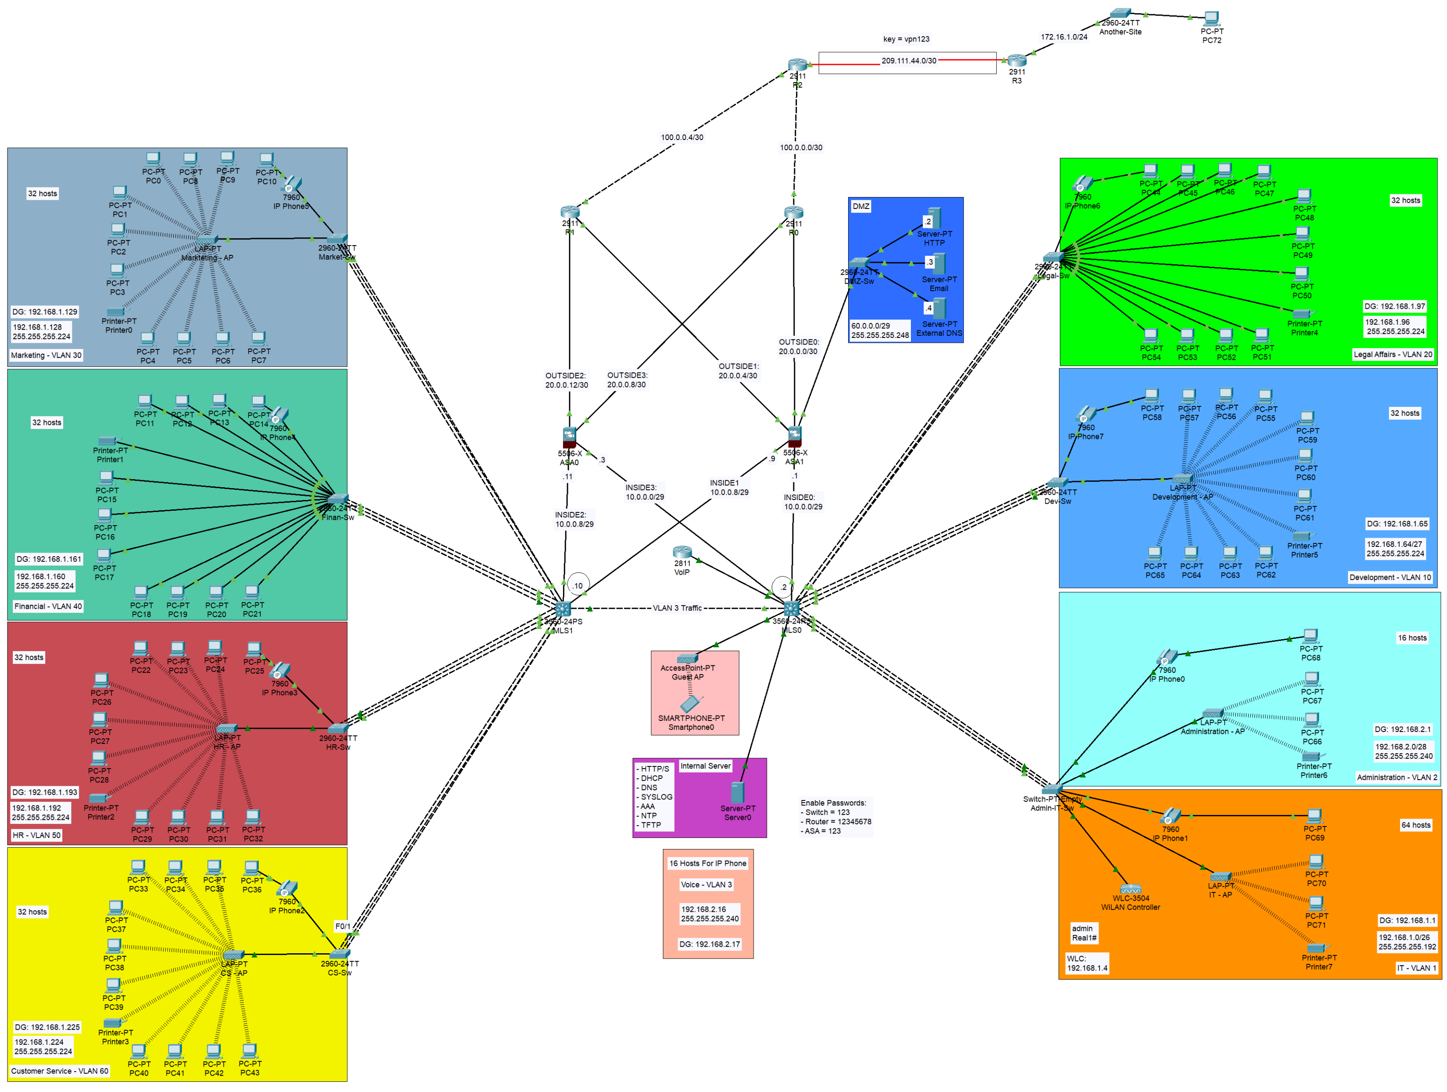

Slide 7
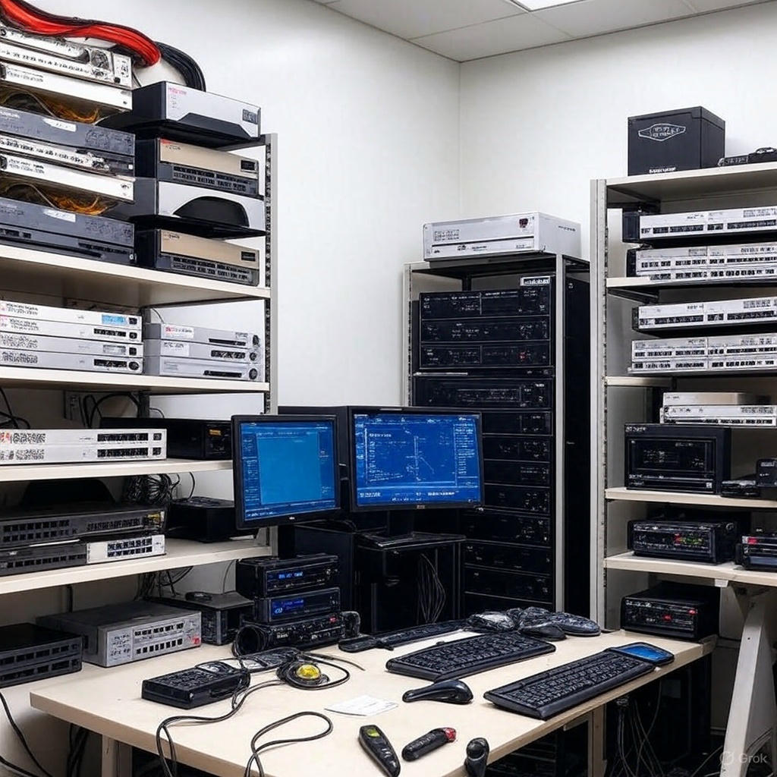
Device Inventory
🖥️ 72 PCs
☎️ 8 IP Phones
🖨️ 8 Printers
📶 1 Wireless LAN Controller
📡 6 Light Weight AP
🛜 1 Stand alone AP
🔁 8 Layer 2 Switches
🔁 2 Multi-layer Switches
📠 4 Servers
🧱 2 ASA Firewalls
🌐 5 Routers

Slide 8

VLSM and IP Addressing
Variable Length Subnet Masking (VLSM):
Optimizes IP address allocation for VLANs.
Example Subnets:
Default/IT (VLAN 1): 192.168.1.0/26 (64 hosts)
Development (VLAN 10): 192.168.1.64/27 (32 hosts)
Guest Wi-Fi (VLAN 111): 192.168.2.32/30 (4 hosts)
Other Networks:
DMZ: 60.0.0.0/29
INSIDE: 10.0.0.0/29, 10.0.0.8/29
OUTSIDE: 20.0.0.0/30, 20.0.0.4/30

Slide 9
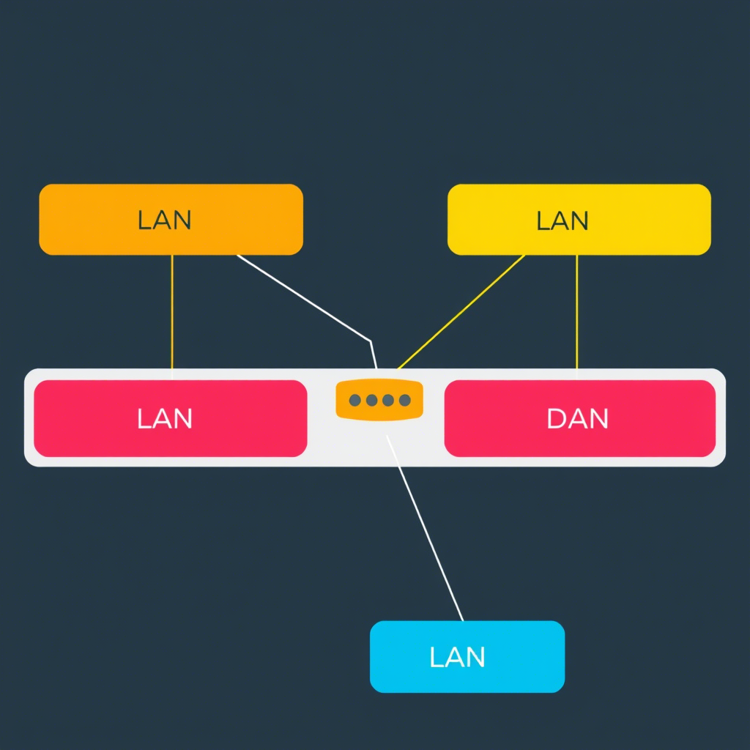
VLAN Configuration
VLANs Implemented:
VLAN 1: Default (IT, DMZ)
VLAN 2: Administration
VLAN 3: Voice
VLAN 10–60: Departmental (Development, Legal, Marketing, Financial, HR, Customer Service)
VLAN 111: Guest Wi-Fi
VLAN 404: Black-Hole (unused ports) VTPv2: Centralized VLAN management with MLS1 as server, others as clients.

Slide 10
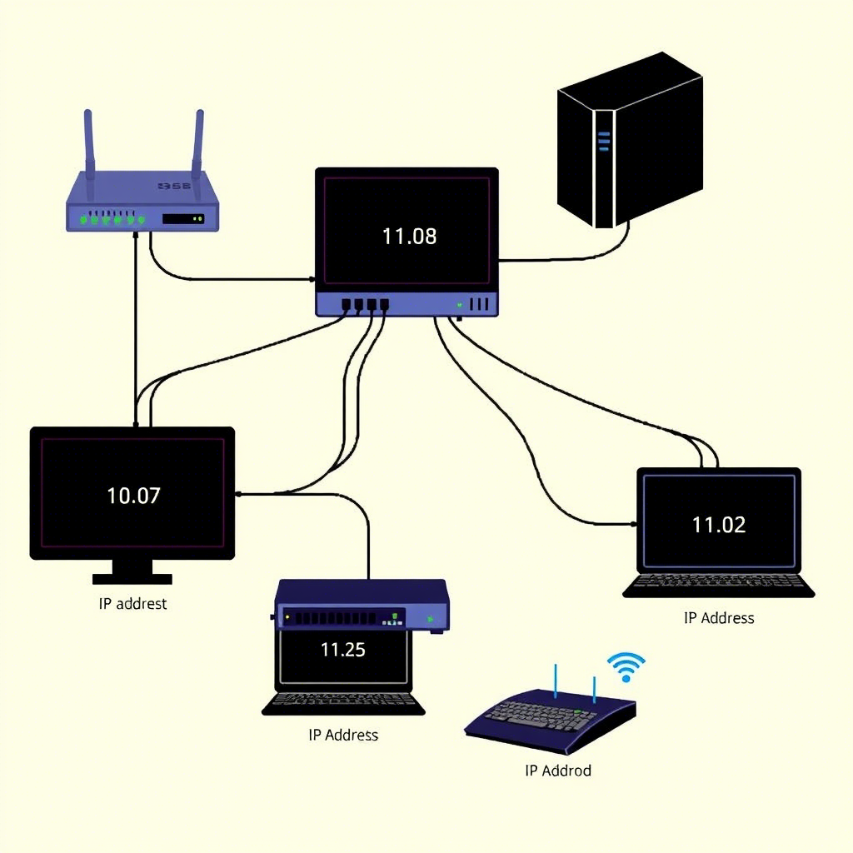
Network Devices and IP Assignment
Devices:
MLS (Layer 3 Switch): VLAN interfaces (e.g., VLAN 1: 192.168.1.1/26).
ASA Firewalls: Interfaces for INSIDE, OUTSIDE, DMZ (e.g., ASA1 G1/5: 60.0.0.1/29).
Routers (R0–R3): External connectivity (e.g., R0 G0/1: 20.0.0.2/30).
Switches: Departmental (e.g., Market-Sw: 192.168.1.132/27).
Servers: HTTP (60.0.0.2/29), Email (60.0.0.3/29), DNS (60.0.0.4/29).

Slide 11

Port Channel Configuration
EtherChannels for Redundancy and Bandwidth:
Protocols: LACP and PAgP for link aggregation.
Left Side:
Group 1: Finan-Sw to MLS1 (F0/13-15, PAgP)
Group 2: Market-Sw to MLS1 (F0/2-4, LACP)
Right Side:
Group 1: Legal-Sw to MLS0 (F0/13-15, PAgP)
Group 2: Dev-Sw to MLS0 (F0/2-4, PAgP)

Slide 12
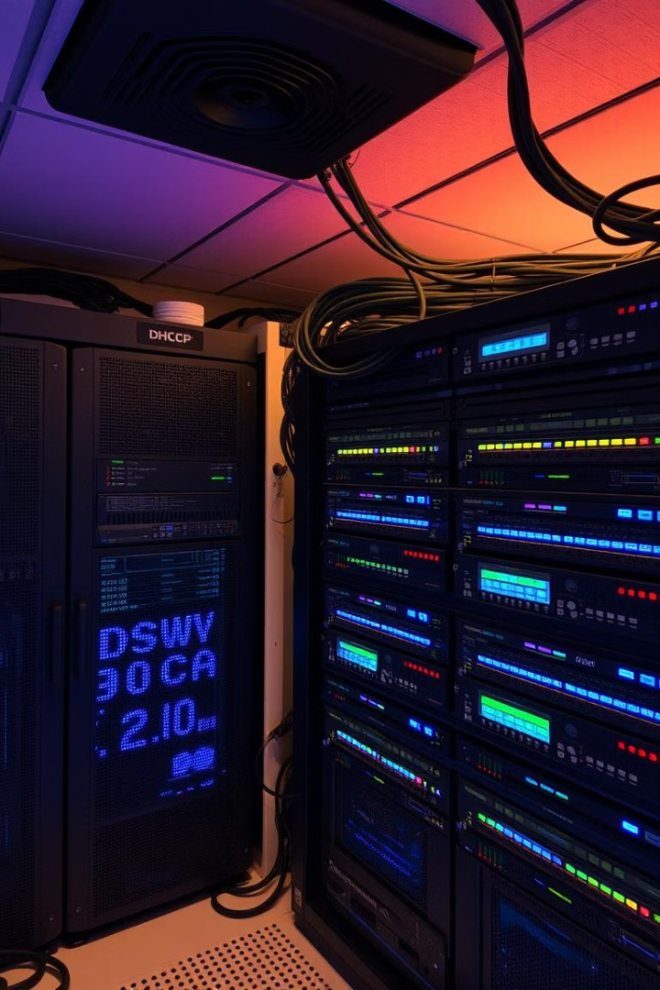
Additional Services
Supporting Services:
DNS: Resolves domain names for network operations.
SYSLOG: Centralized logging for monitoring and troubleshooting.
TFTP: Stores device configurations and IOS images.
Email Server: Handles SMTP, IMAP, POP3 for communication.
Web Server: Hosts internal/external web applications.
Timestamps: Enhances log and debug analysis.
DHCPv4: Automated IP assignment for efficiency.
NTP: Time synchronization for logs and security.

Slide 13
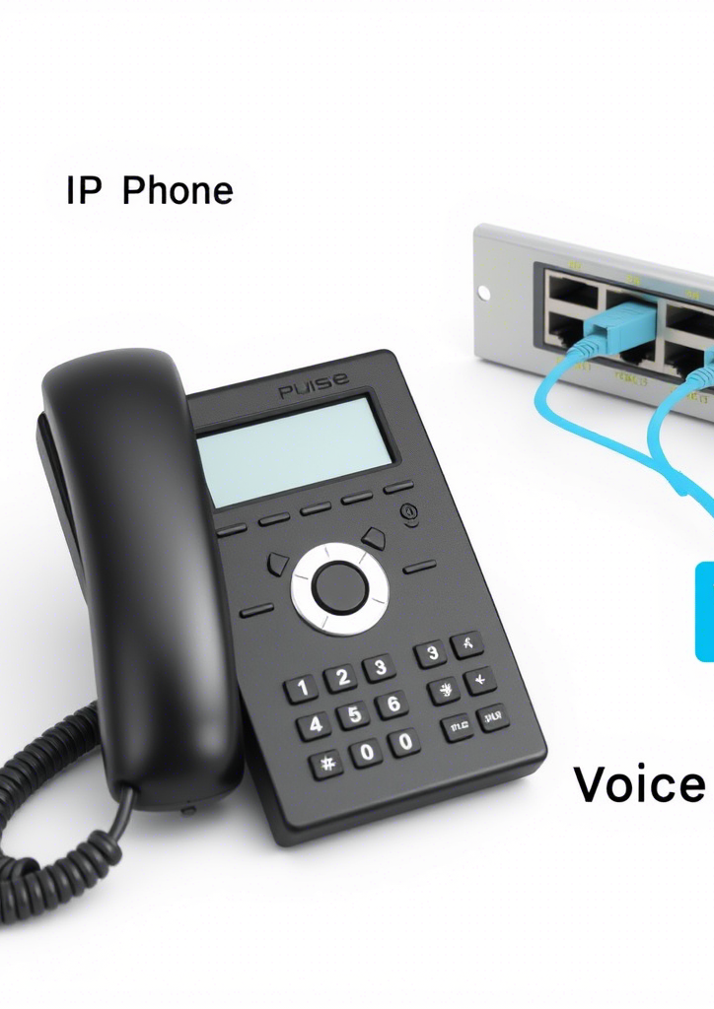
IP Phone and Voice VLAN
IP Phone Configuration:
Dedicated Voice VLAN (VLAN 3) for QoS.
Phones assigned via DHCP, connected to TFTP server.
Examples:
Phone 0: Administration (Line 2)
Phone 2: Customer Service (Line 60)
Phone 7: Development (Line 10) Purpose: Prioritize voice traffic for clear, reliable telephony.

Slide 14

Network Optimization
Performance Enhancements:
Rapid-PVST: Fast spanning-tree convergence.
PortFast: Immediate access port connectivity.
LACP/PAgP: Aggregated links for bandwidth and redundancy.
Inter-VLAN Routing: Layer 3 switching for secure communication.
Logging Synchronous: Uninterrupted command output.
No IP Domain-Lookup: Faster CLI navigation by preventing accidental DNS queries.

Slide 15
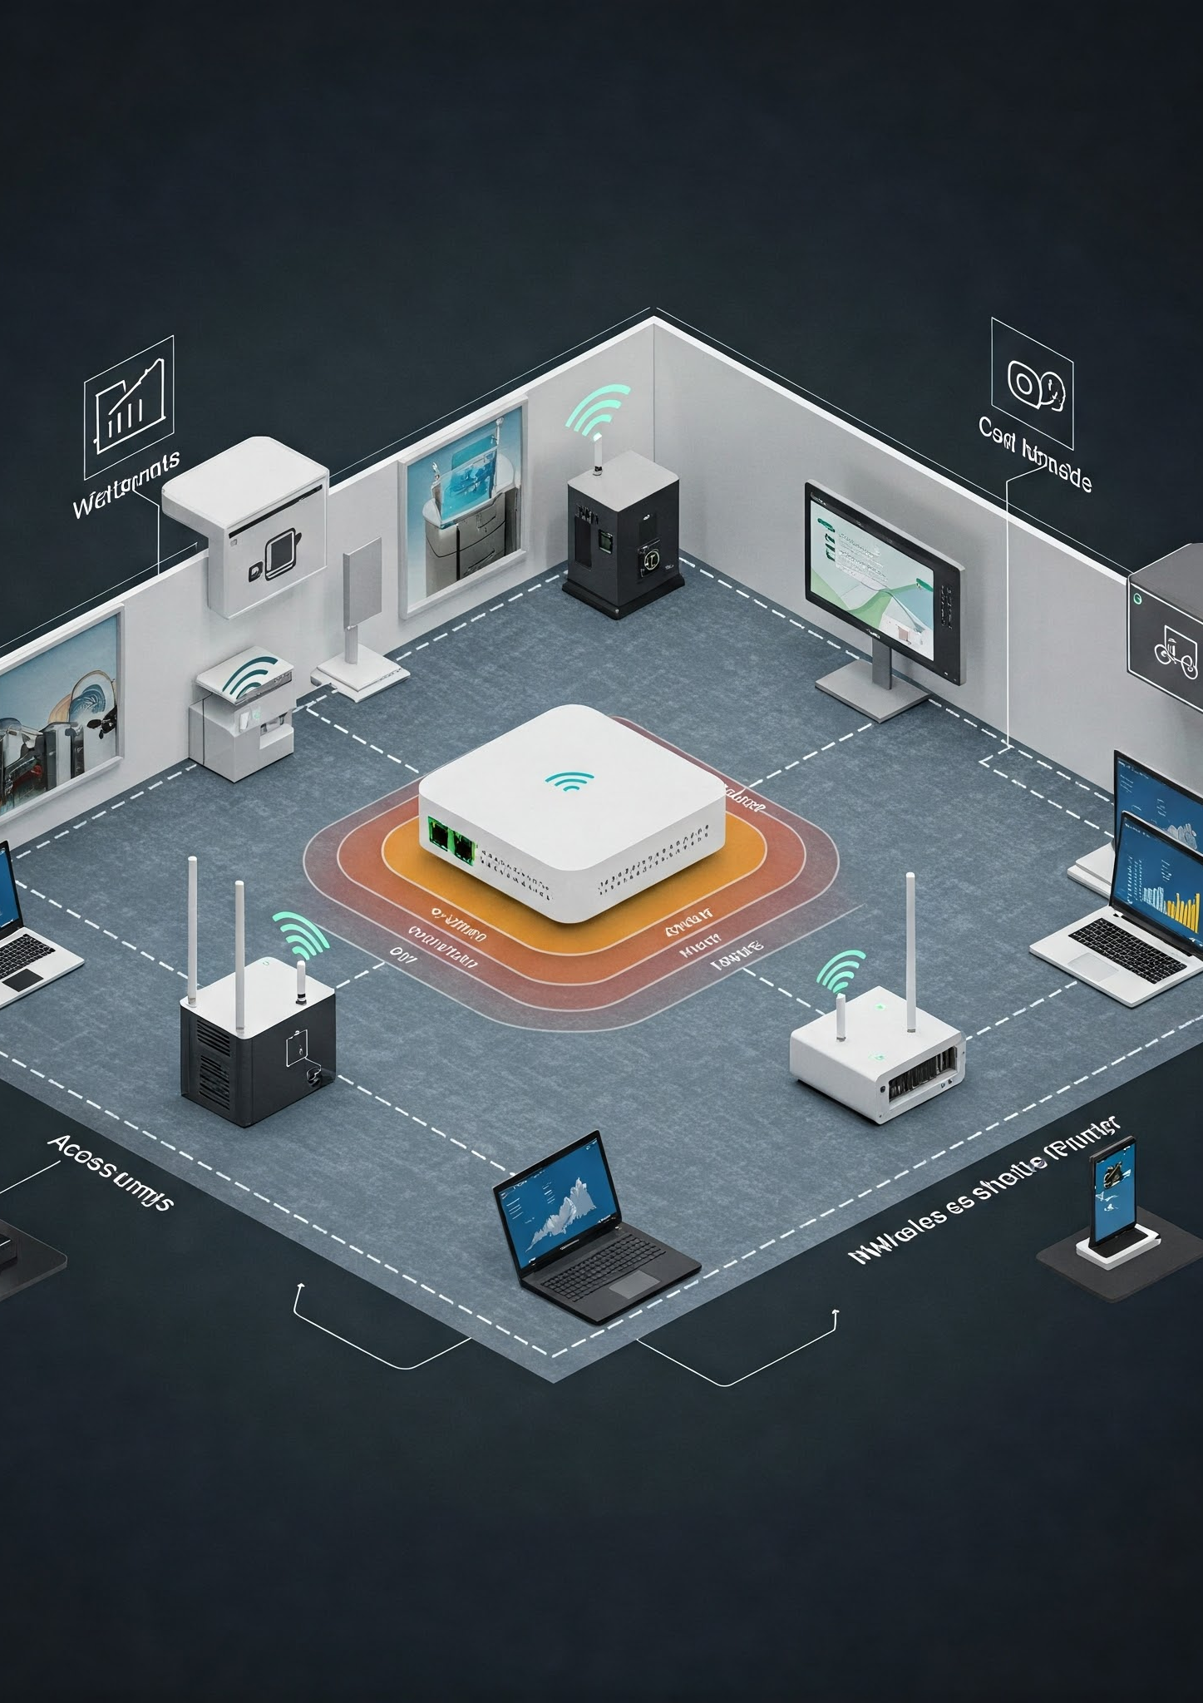
Wireless and Guest Access
Wireless Infrastructure:
Employee Wi-Fi: Secured with 802.1x and RADIUS authentication.
Guest Wi-Fi: (Standalone AP) Isolated on VLAN 111 (192.168.2.32/30).
Lightweight APs: Managed by Wireless LAN Controller (WLC) via CAPWAP. Purpose: Secure, segregated wireless access for employees and guests.

Slide 16

Port and Device Hardening
Security Best Practices:
Shutdown Unused Ports: Prevents unauthorized access.
Black-Hole VLAN: Isolates unused ports (VLAN 404).
Disable CDP/LLDP/DTP: Reduces attack surface on unused ports.
Password Encryption: Secures credentials.
Session Timeout: Terminates inactive sessions.
Account Lockout: Blocks accounts after failed login attempts.
Port Security: Limits MAC addresses per port.
BPDU Guard: Prevents BPDU attacks.

Slide 17

Routing and Connectivity
Routing Configuration:
OSPF: Dynamic routing for internal networks.
Static/Default Routes: Controlled external access.
PAT: Maps multiple private IPs to a single public IP.
Site-to-Site VPN: Secure inter-site communication via IPsec. Purpose: Scalable, secure, and efficient network connectivity.

Slide 18
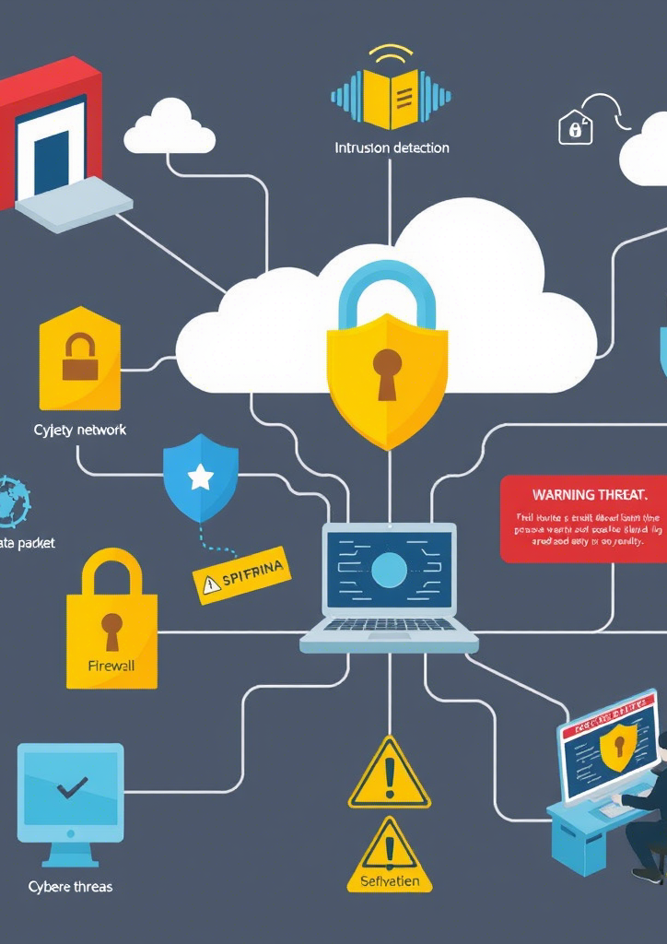
Security Features
Key Security Measures:
Cisco ASA Firewall: Threat defence, intrusion prevention, traffic filtering.
ACLs: Restrict inter-VLAN and Internet traffic.
AAA with RADIUS: Centralized authentication for CLI access.
SSHv2: Encrypted remote management.
DHCP Snooping & ARP Inspection: Defend against spoofing attacks.

Slide 19

Conclusion
Summary:
Designed a secure, segmented network for a small business.
Implemented VLANs, VLSM, and advanced security (ASA, ACLs, VPN).
Optimized performance with Rapid-PVST, LACP, and DHCP.
Provided secure wireless and voice services.
Future Steps:
Monitor network performance and scale as needed.
Update security policies to address emerging threats.

Slide 20

Thanks
Feel free to ask any questions or share your thoughts on port security

